Slide 2
O que há de novo no ML.NET? (Machine Learning para .NET)
Sérgio Prates
Engenheiro de Software
Lambda3
@sergiopratess

Slide 3
ML.NET introduction session (//Build2019)
//BUILD 2019/ (May 2019)
Session: Introducing ML.NET: https://aka.ms/mlnetbuild2019
Agenda for today at the .NET Conf 2019
.NET Conf 2019 (September 2019)
Session: What’s new in ML.NET?
Short intro on ML.NET and Model Builder in VS
What’s new:
New Database Loader
Deep Learning training in ML.NET: Image Classification API (Native TensorFlow training)
Notes:
Other talks on ML.NET introductions:
https://channel9.msdn.com/Shows/On-NET/Machine-Learning-with-MLNET-10-from-Build-2019
Build2019 at YouTube: https://www.youtube.com/watch?v=pxUzw6JyqcM

Slide 4
Introdução Rápida ML.NET

Slide 5





ML.NET Um framework para machine learning open source e cross-platform
Criado para desenvolvedores
.NET
Cenários customizados
C#
F#
Extensível com TensorFlow & mais
Confiável & comprovado em escala
http://dot.net/ml
Notes:
Use existing .NET skills to easily integrate ML models into your .NET apps
Productive tooling
Leverage other popular libraries like TF and ONNX for additional scenarios
TLC

Slide 6
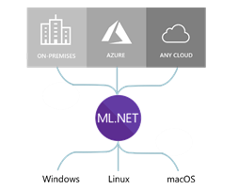
ML.NET roda (quase) em qualquer lugar…
Frameworks:
.NET Core (Nativamente)
.NET Framework (Nativamente)
Python com NimbusML (Python bindings)
Arquiteturas suportadas:
x64
x86

Slide 7
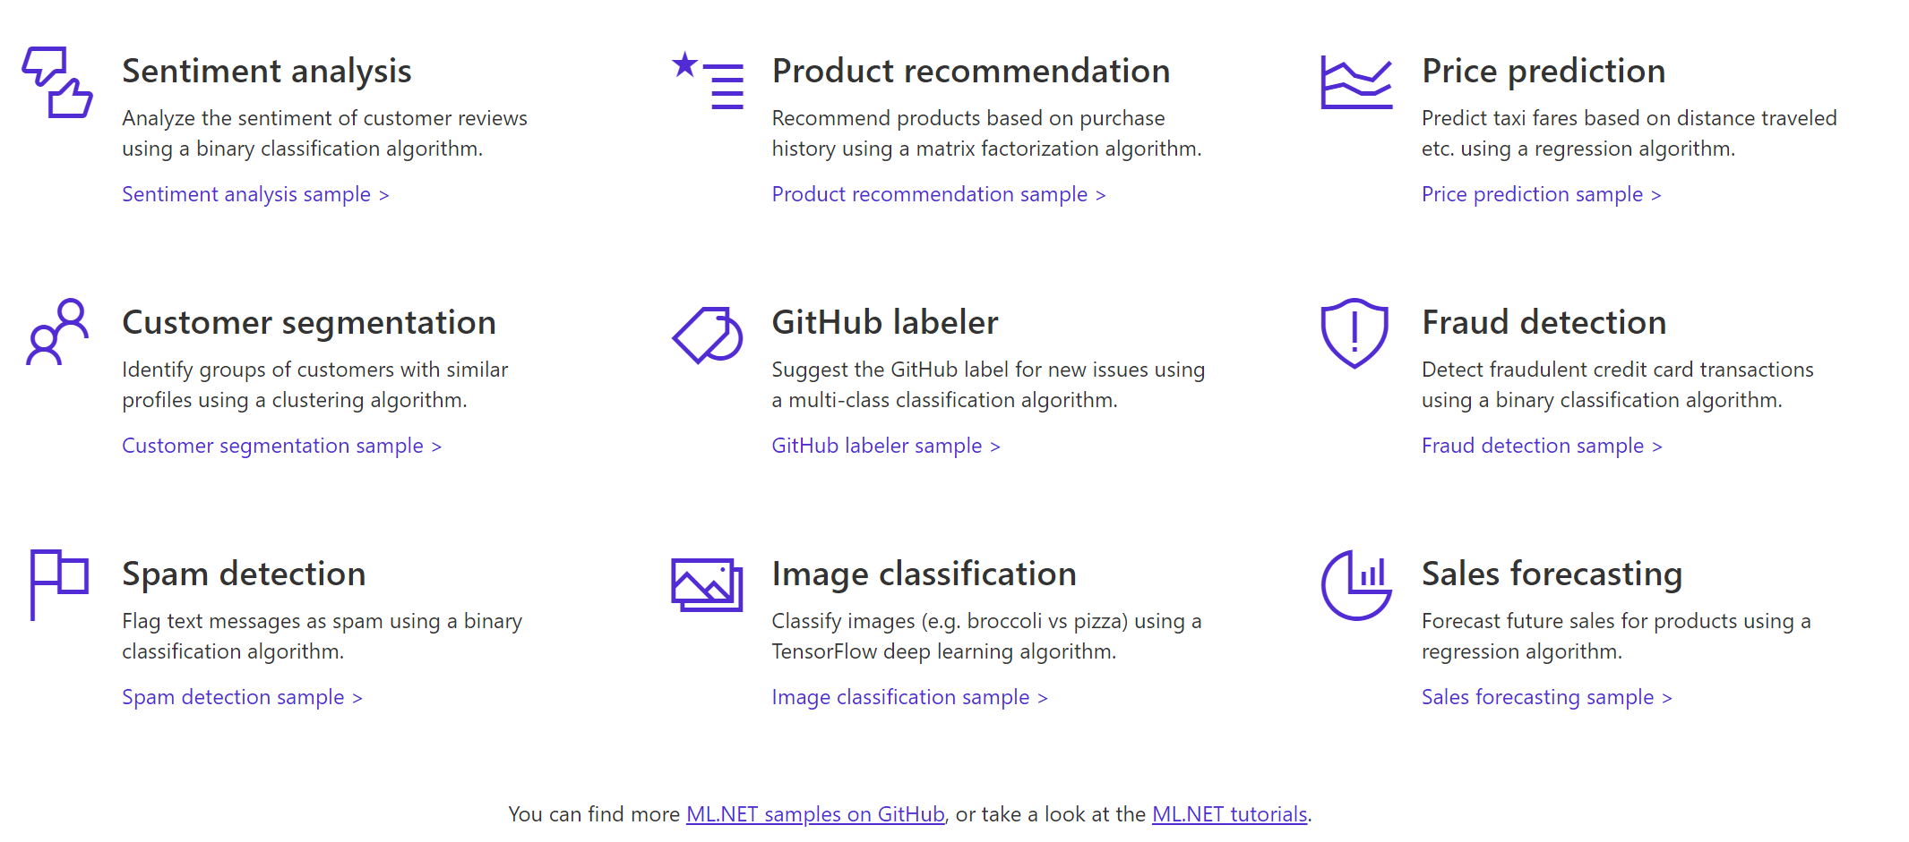

Algumas coisas que você pode fazer com ML.NET …
E mais! Exemplos @ https://github.com/dotnet/machinelearning-samples
Notes:
So here’s an example of a few things you can do today with ML.NET 1.0
You can perform Sentiment Analysis, build Product recommenders,
forecast sales,
classify images and do a whole lot more.
And for all these scenarios we have provided you sample code for building and consuming these models, let me show you.
____
Dot.net
Here’s our dot.net/ml page which talks about some of the value props I mentioned, heres a list of samples.
So here is our samples repo, Here we have many samples for each ML task e.g. Fraud Detection for classification, Issue Classification, Sales Forecast etc.
For each of these samples we also provide you both the training code and consumption code along with explaining you how we built them
Alright so let me show you one of these samples live.
Here I have the sentiment analysis + blazor application

Slide 8




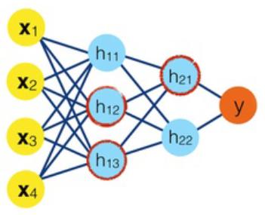



Etapas de Machine Learning
Datasets
ML model
ML model
Prepare seus dados
Construa e treine
Execute
App/Ferramentas para treinar seu modelo
App do usuário final
usando o modelo ML
Criação do modelo
Consumo do modelo
Notes:
3 main steps
Preparing your data – labeling, merging different data sources, cleaning up the data, and data transformations
Feed prepared data to algorithm and train the model (using algorithm with the data)
Consume model
TALKING POINTS:
There are two very different applications and contexts:
Prepare Data and Train the model Happens at development/research time, in your private app & tools for building the model
You run the model in the end-user application

Slide 9


Três formas para usar o ML.NET…
C#
>_
ML.NET
API
(Code)
ML.NET
Model Builder
(Visual Studio UI)
ML.NET
CLI
(Command-Line Interface)

Slide 10
A maneira mais fácil de criar um modelo ML.NET: Model Builder no Visual Studio

Slide 11
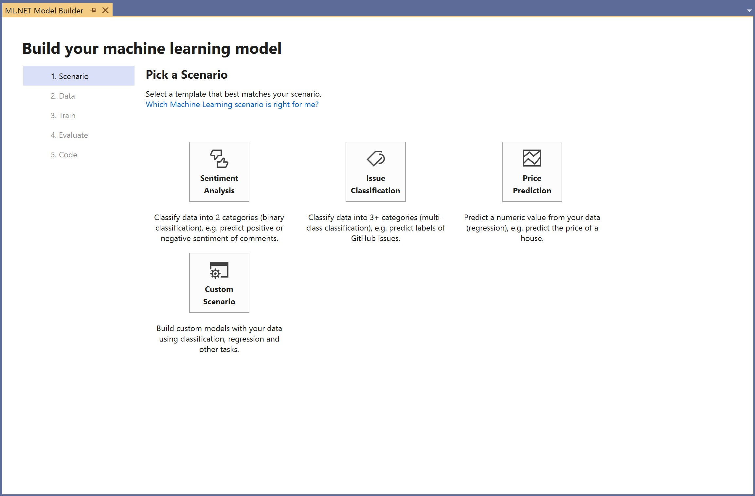
ML.NET Model Builder
Machine learning acessível no Visual Studio
Uma simples interface para criar modelos customizados com Auto ML
Carregue com arquivos e bases de dados
Gere o Código para treinamento e consumo
Execute em qualquer lugar
Download VS vsix:
http://aka.ms/mlnetmodelbuilder

Slide 12
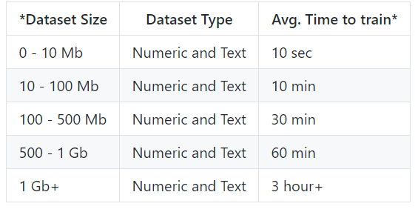
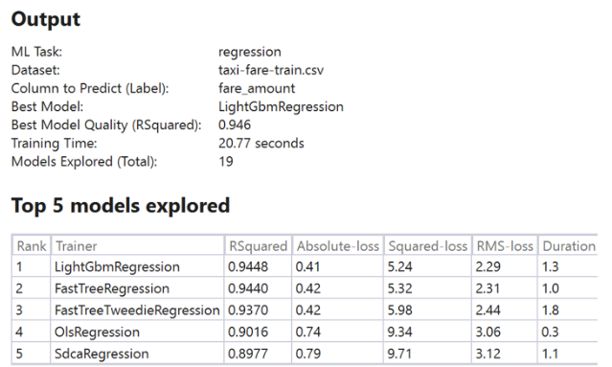
ML.NET Model Builder
Pontos importantes:
Exemplo de saída do model builder:
Um dataset de 1 TB demorou pouco mais de quatro dias para um modelo de qualidade.
Ele separa seus dados em treino e teste.

Slide 13
Demo 1: Model Builder in Visual Studio

Slide 14
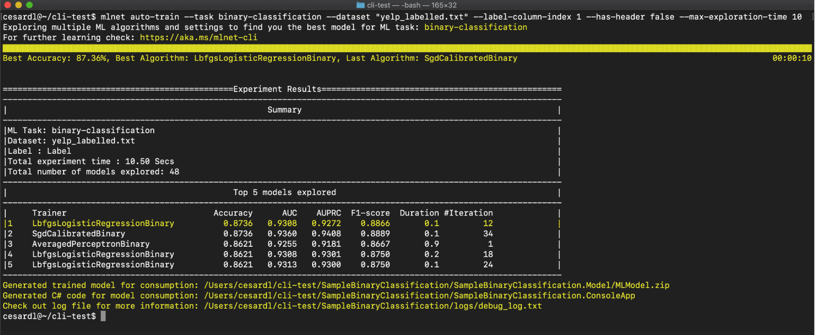
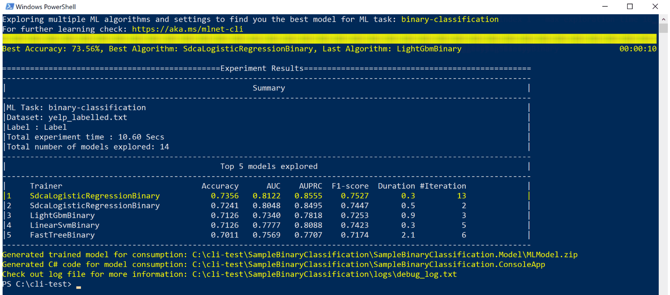
ML.NET CLI
Use o CLI para facilmente construir modelos de ML com Auto ML
Cross platform (Windows, Linux, MacOS)
Gere Código para o treinamento e teste
macOS / Linux (Bash)
Windows (PowerShell and CMD)
> mlnet auto-train --ml-task binary-classification --dataset "customer-reviews.tsv" --label-column-name Sentiment

Slide 15
O que há de novo desde Maio de 2019?

Slide 16
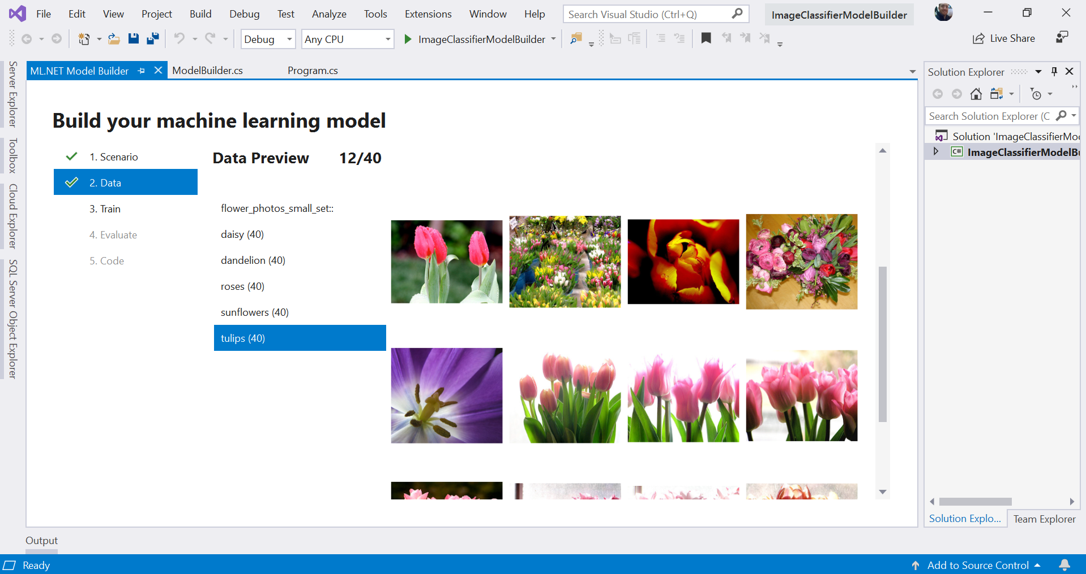
Classificação de Imagens com ML.NET Model Builder
Carregue as imagens diretamente das pastas
Ainda não está em preview
Notes:
An image classifier is a deep learning model that recognizes images. When you give it an image, it responds with a label for that image.
NASNet: https://ai.googleblog.com/2017/11/automl-for-large-scale-image.html

Slide 17

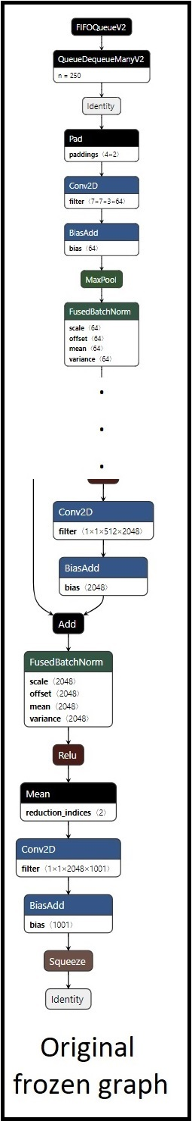
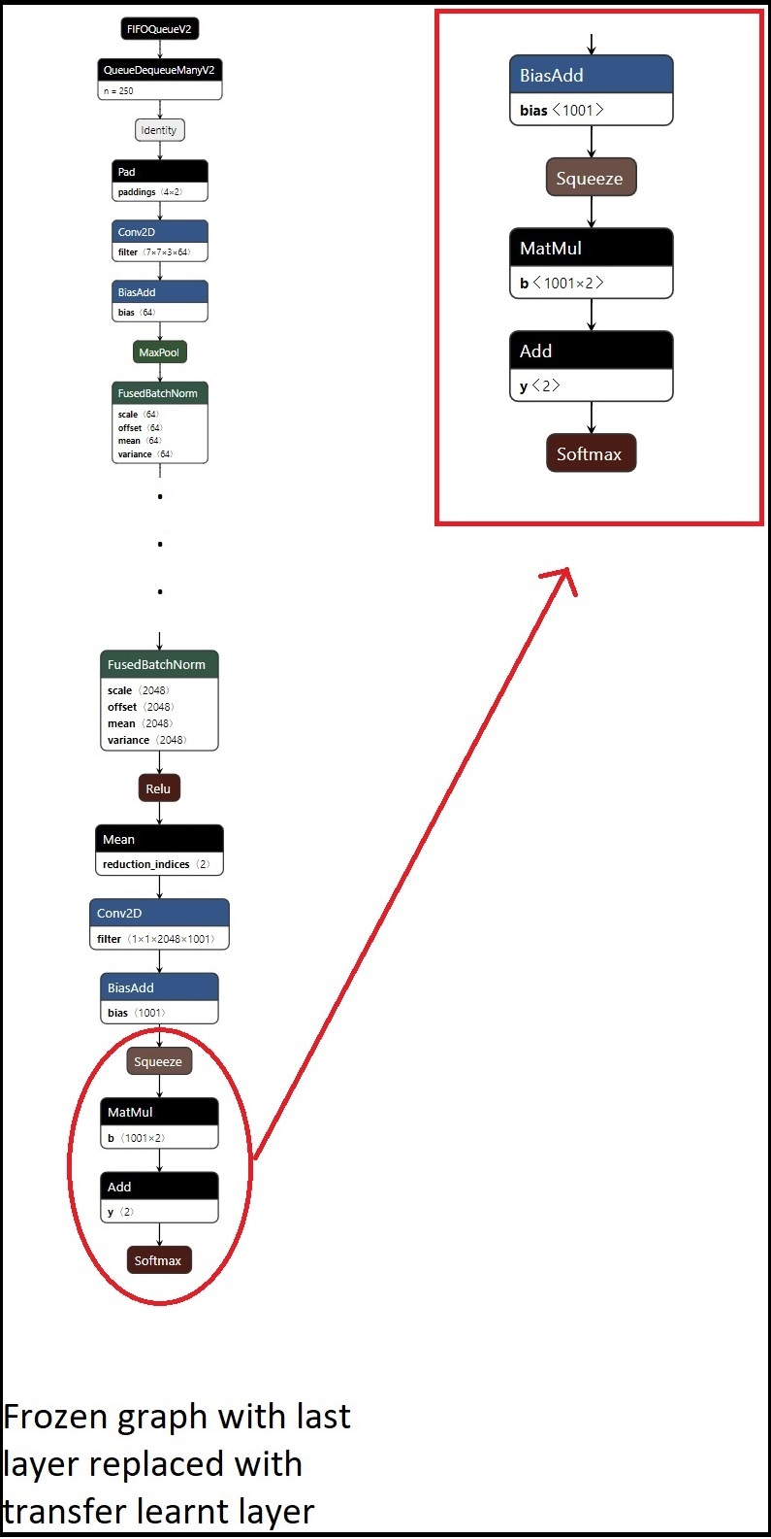
Transfer learning com TensorFlow com ML.NET ImageClassifier
(Preview)
Benefícios:
DNN transfer learning nativo: Transfer Learning acontece em cima do modelo do tensorflow, não utilizando o modelo do ml.net
Poder e otimização: Podemos retreinar uma ou mais camadas com o gráfo do tensorflow.
Pre-trained
TensorFlow model
DNN graph
(i.e. Inception, ResNet, etc.)
Final trained custom
TensorFlow model
DNN graph
(With Transfer learning)
Original
Pre-trained
.meta file
Re-trained
graph
Transfer
Learning
Re-train
Dependencias internas para o TensorFlow
Dependencia da biblioteca TensorFlow.NET que é como os bindings são feitos C#
Dependencia do binário do tensorflow.
Frozen graph with last layer replaced with the transferred learning layer with the new re-training
Notes:
SPECS: https://github.com/dotnet/machinelearning/blob/cd591dd492833964b6829e8bb2411fb81665ac6d/docs/specs/DNN/dnn_api_spec.md

Slide 18
O que há de novo para leitura de dados?: Database Loader

Slide 19

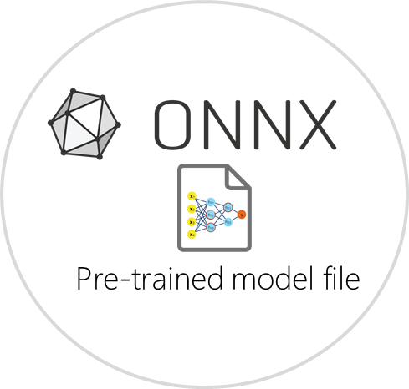
Database Loader
Cenários possíveis:
Treinamento diretamente sobre bancos de dados relacionais.
Código simples
Suporta qualquer RDBMS suportado por System.Data
Atualmente em preview (1.4-preview release)
Treina sobre
Banco relacional
C# Código de treinamento para criar um Modelo ML
SQL Server
Oracle
PostgreSQL
MySQL
etc.

Slide 20
Demo 2: Database Loader

Slide 21
O que há de novo em: Deep Learning com ML.NET

Slide 22

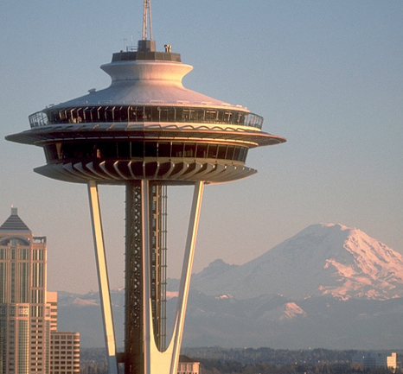
Use Modelos de Deep Learning com ML.NET
Adicione inteligência baseado em DNN para seus apps .NET
Permite visão computacional e muito mais modelos de Deep Learning
Imagem (input)
Cachorro
!Cachorro
Cachorro
!Cachorro

Slide 23



Bibliotecas líderes em deep learning e interoperabilidade
PyTorch
A estratégia da Microsoft é integrar estas bibliotecas de baixo nível no ML.NET:
Atualmente suportado pelo ML.NET:
- TensorFlow
- ONNX
Está no roadmap de longo prazo do ML.NET:
- Torch

Slide 24


Transfer learning em TensorFlow com ML.NET ImageClassifier
(Preview)
Benefício: API de alto nível orientado à tarefas de ML: ‘Classificação de Imagens’
Pre-trained
TensorFlow model
DNN graph
(i.e. Inception, ResNet, etc.)
Final trained custom
TensorFlow model
DNN graph
(With Transfer learning)
Pipeline do ML.NET criando um novo modelo re-treinado do TensorFlow usando transfer learning
var pipeline = mlContext.Transforms.Conversion.MapValueToKey("Label")
Re-trained
graph
.Append(mlContext.Model.ImageClassification("Image", "Label",
arch: DnnEstimator.Architecture.InceptionV3));
var trainedModel = pipeline.Fit(trainDataset);
Original
Pre-trained
.meta file
Transfer
Learning
Re-train
Novo modelo TensorFlow
Retreinado com transfer learning
(.pb file)
Novo modelo ML.NET
Um simples wrapper para execução em .NET
(.zip file)
Frozen graph with last layer replaced with the transferred learning layer with the new re-training
End-user C# app
Scoring/predicting
with model
C# app
Final
re-trained
.pb file
Blog Post: Training Image Classification/Recognition models based on Deep Learning & Transfer Learning with ML.NET
Notes:
SPECS: https://github.com/dotnet/machinelearning/blob/cd591dd492833964b6829e8bb2411fb81665ac6d/docs/specs/DNN/dnn_api_spec.md

Slide 25
Utilização de modelos ‘pré-treinados’ (Transfer Learning) (DNN architectures)
Visão Computacional
Audio e fala
NLP (Processamento de linguagem natural)
Classificação de Imagens
Wavenet
espnet
waveblow
deepspeech2
loop
tacotron
etc.
Google InceptionV3
Microsoft ResNet
NASNet
Oxford VGG Model
MobileNetV2
etc.
Modelos Generativos
… outros domínios…
Detecção de objetos
Yolo (You Only Look Once)
R-CNN
SPP-net
Fast R-CNN
Faster R-CNN
etc.
Alto investimento/custo em pesquisa sobre arquitetura DNN mais o custo de treinamento com grandes datasets feito por organizações como Google, Microsoft, Facebook, Universidades e pesquisadores.
Você pode obter a vantagem de simplesmente consumir modelos pré-treinados
https://modelzoo.co/categories
Notes:
https://modelzoo.co/categories
https://cv-tricks.com/object-detection/faster-r-cnn-yolo-ssd/

Slide 26
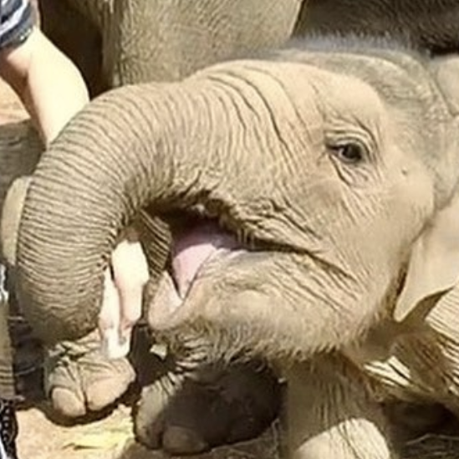

Consuming pre-trained deep learning models with ML.NET Scenario: Image classifier (Consuming the model)
Pre-trained
Deep learning model
(i.e. Image classifier)
“dog”
“elephant”
“flower”
“person”
“car”
Pre-defined list of
generic labels
Examples of pre-trained models (Image classifiers):
Google Inception v3, NASNet
Microsoft ResNet
Oxford VGG Model, etc.
GitHub sample here
Notes:
An image classifier is a deep learning model that recognizes images. When you give it an image, it responds with a label for that image.
NASNet: https://ai.googleblog.com/2017/11/automl-for-large-scale-image.html

Slide 27
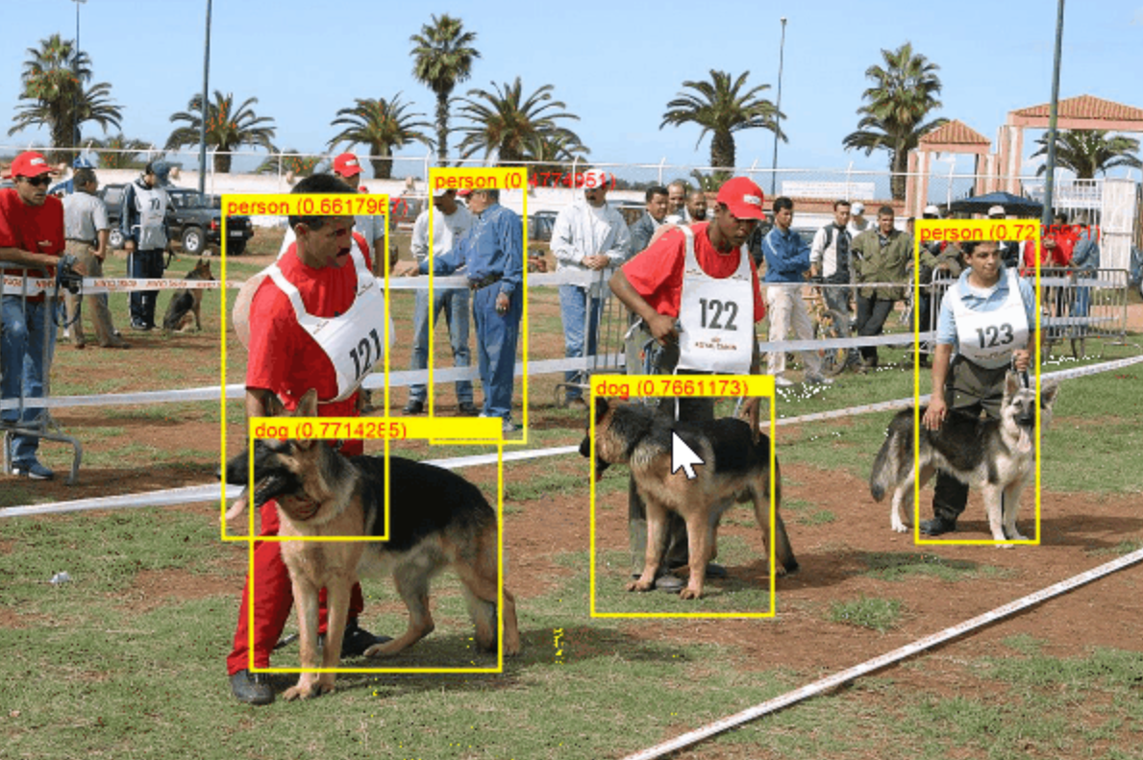

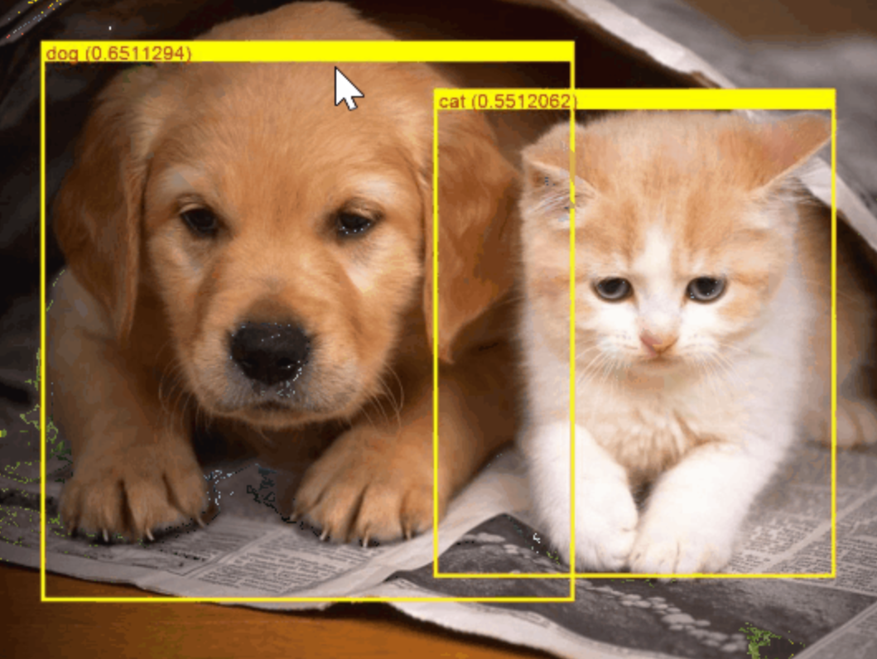

Consuming pre-trained deep learning models with ML.NET Scenario: Object Detection (Consuming the model)
Pre-trained
Deep learning model
(i.e. Object Detection)
Examples of pre-trained
models for obj. detection:
YOLO (You Only Look Once)
Faster R-CNN
SSD, etc.
GitHub sample here
Notes:
An image classifier is a deep learning model that recognizes images. When you give it an image, it responds with a label for that image.
NASNet: https://ai.googleblog.com/2017/11/automl-for-large-scale-image.html

Slide 28
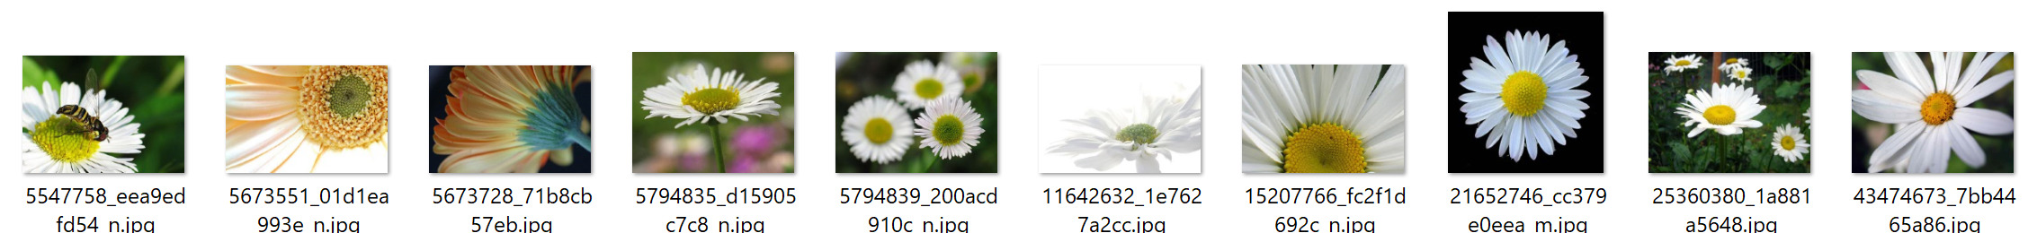
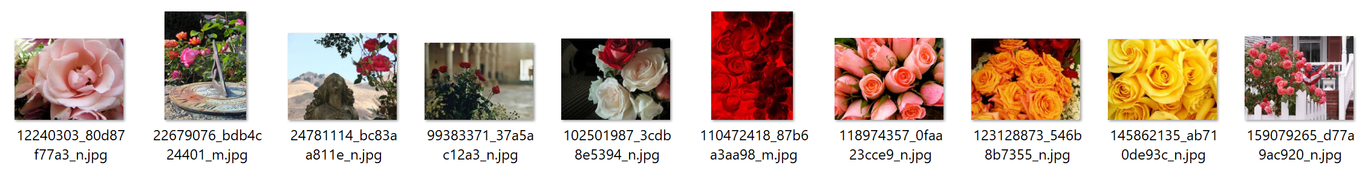
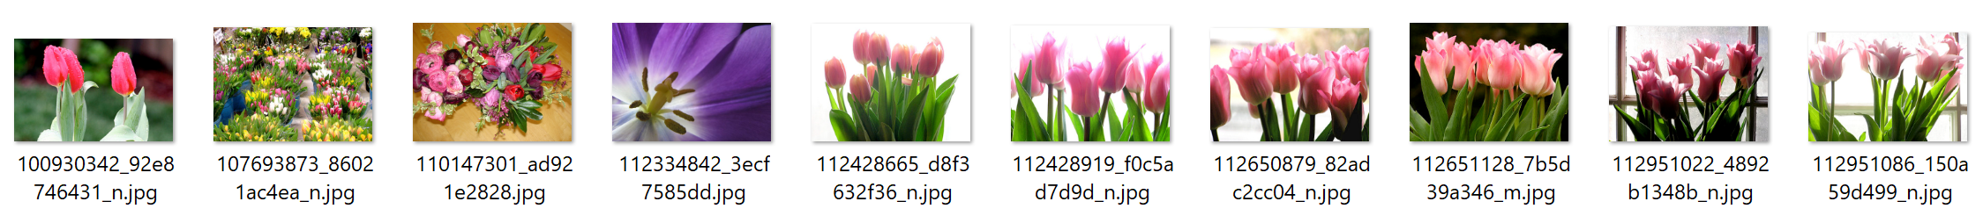
What if I want to classify based on my own custom domain? Scenario: Image classifier (Training)
Then you train your own custom deep learning model with ML.NET
“daisies”
Your custom Image Classifier
(Deep learning model)
“roses”
Train
“tulips”
When training, ML.NET is based on TensorFlow underneath (Transfer Learning).
ML.NET currently supports “ImageClassifier training” ( Preview)
Object Detection training will come soon
Notes:
An image classifier is a deep learning model that recognizes images. When you give it an image, it responds with a label for that image.
NASNet: https://ai.googleblog.com/2017/11/automl-for-large-scale-image.html

Slide 29
Demo 3: Training custom Deep Learning models with Model Builder - Image Classification task (Preview)

Slide 30
Demo 4: Training custom Deep Learning models with ML.NET (NEW transfer learning based API) - Image Classification task (Preview)

Slide 31
O que há de novo para Exploração de dados, Experimentação de ML e formas orientadas ao aprendizado?

Slide 32
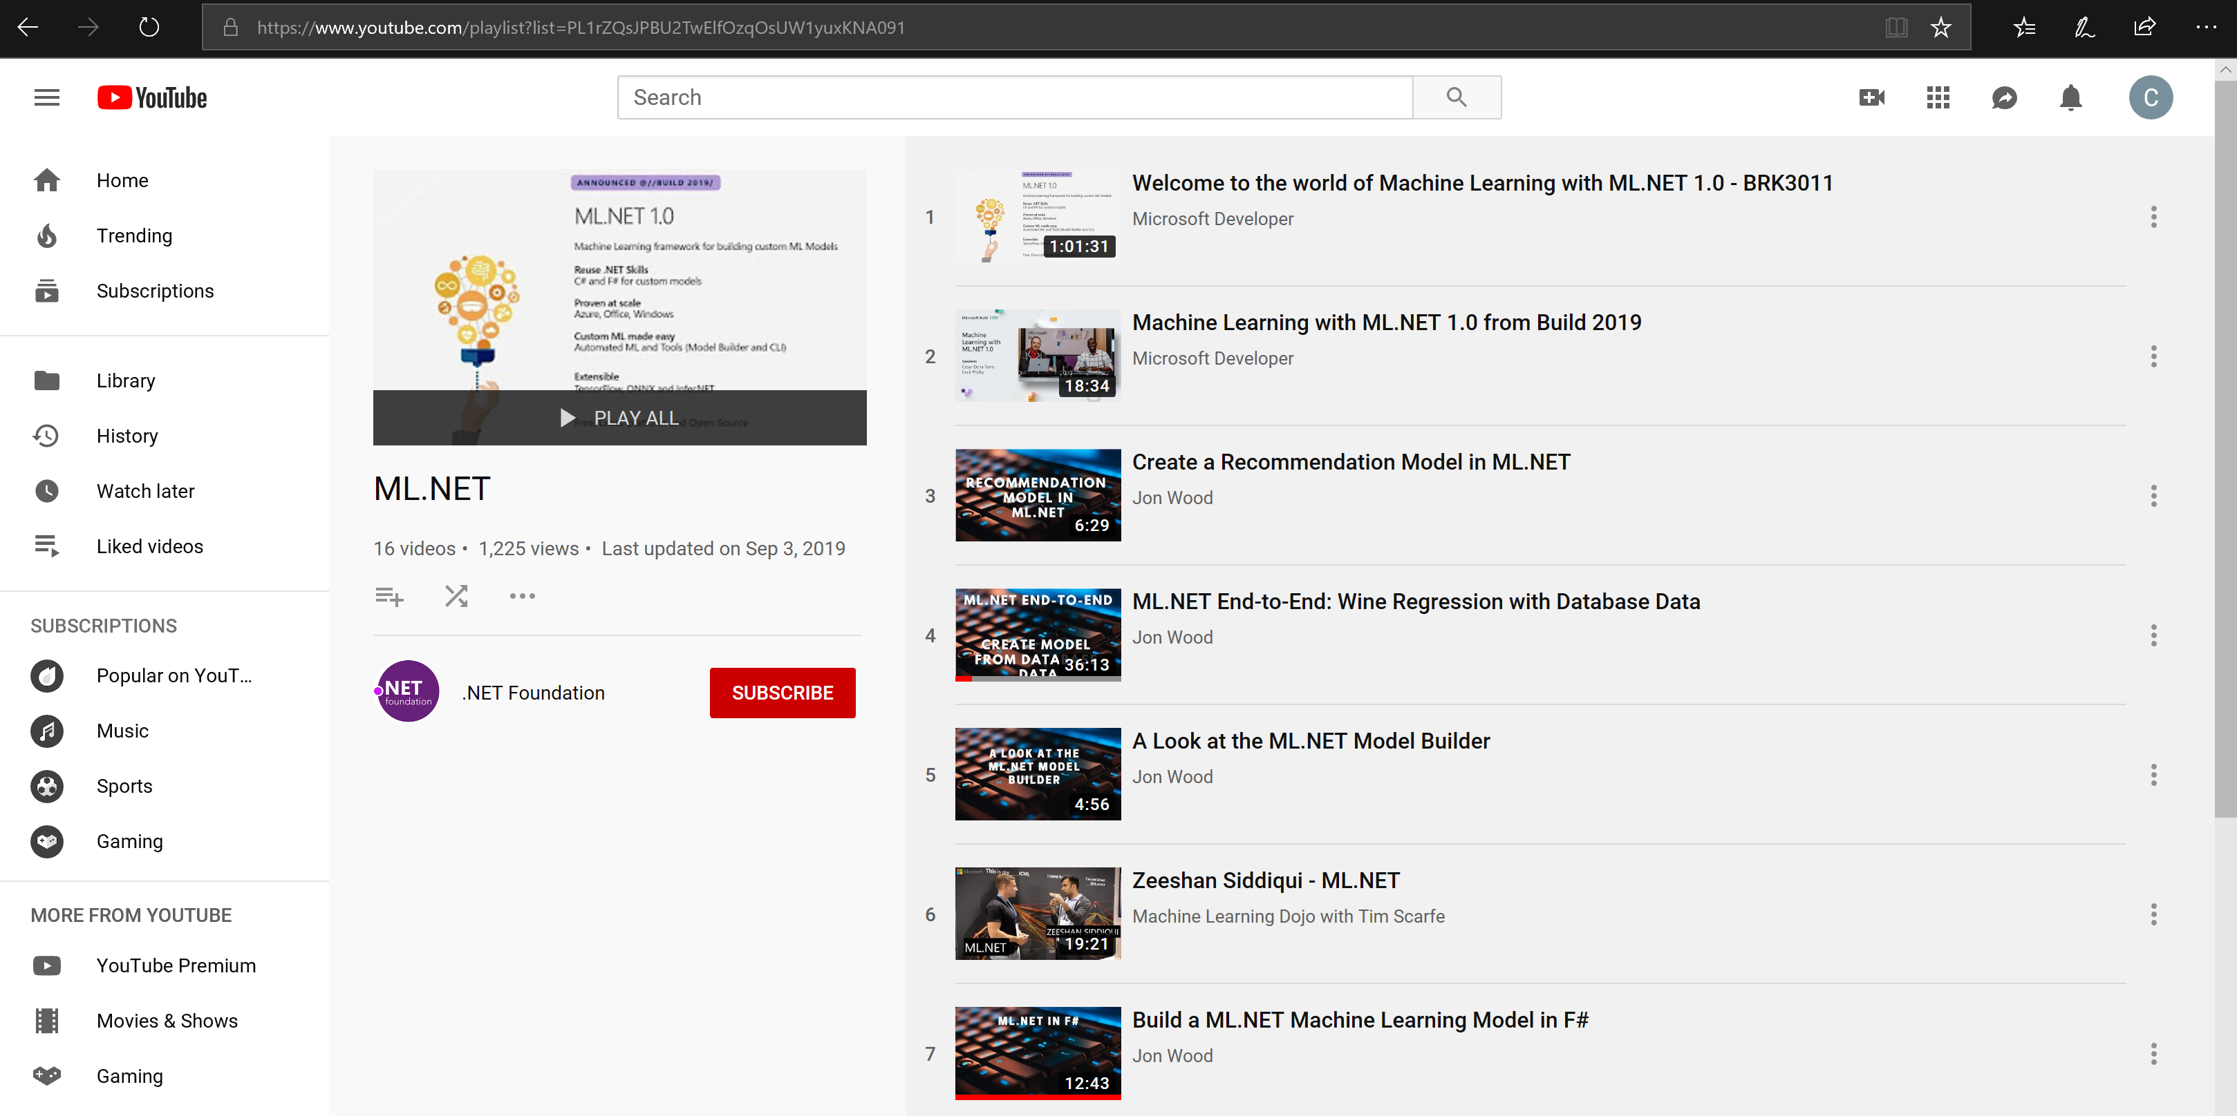
Other important features in ML.NET
DevOps & ML Model lifecycle with Azure DevOps CI/CD pipelines
Model Explainability and Feature input variables importance
Cross-validation of ML.NET models:
Loading data from ‘anywhere’ through the LoadFromEnumerable() method
Using huge and sparse datasets (thousands or millions of columns)
Deploy ML.NET model into high scalable and multi-threaded ASP.NET Core apps and services
Deploy ML.NET model into an Azure Function
Plus many more ML Tasks and scenarios (see samples here: https://github.com/dotnet/machinelearning-samples ) such as:
Sentiment analysis, Spam detection, Fraud Detection, text classification, products recommendations, data spike detection, clustering, ranking results, etc.
Check out many of those scenarios at the ML.NET YouTube playlist:
https://aka.ms/mlnetyoutube

Slide 33
Roadmap
Introdução de treinamento de modelos de deep learning (Preview)
Classificação de imagens e detecção de objetos
Adicionando database loader (Preview)
Melhorias para o ML.NET no Jupyter
Expansão no Azure para treinamento e consume
Melhorar a experiência de AutoML para todos cenários de ML
Melhorar as ferramentas no Visual Studio e .NET (Model Builder & CLI)
Suporte a ARM e ONNX (Facilitadores para Xamarin & IoT)

Slide 34

ML.NET Resources
Get started at http://dot.net/ml
Try the samples at http://aka.ms/mlnetsamples
Read the docs at http://aka.ms/mlnetdocs
Watch ML.NET videos at https://aka.ms/mlnetyoutube
Request features or contribute at http://aka.ms/mlnet

Slide 35
Thank you! ☺
Sérgio Prates
Engenheiro de Software
Lambda3
Twitter: @sergiopratess

Slide 36
Backup slides

Slide 37














Your platform for building anything
DESKTOP
WEB
CLOUD
MOBILE
GAMING
IoT
ML
.NET
Notes:
.NET is a great tech stack for building a wide variety of applications. There is ASP.NET for web development, Xamarin for mobile development and with ML.NET we are trying to make .NET great for Machine Learning.

Slide 38










ML.NET is enterprise-ready battle proven
Microsoft Products
(Using ML.NET internally for > 8 years)
Customers
(ML.NET v1 since May 2019)
Bing - Ad Predictions
Evolution Software – Hazelnut drying time prediction
Excel - Chart Recommendations
Williams Mullen – Law document classification
Power Point - Design Ideas
Sig Parser – E-mail spam detection
Microsoft Defender – Antivirus Threat Protection
Brenmor – Medical patient survey classification
Azure ML Studio – Multiple components
Azure Stream Analytics - Anomaly Detection
endjin – Newsletter article classification
+ more

